Slide 1
AI Design of Quantum Processors
Components 1 & 2 — Generating classical and quantum data for the harmonic oscillator
Marcos Sandoval Lucas
Mondragon-Shem Quantum Group · UIC College of Engineering

Slide 2
CONTEXT
We test whether classical data can predict quantum properties, using the exactly-solvable harmonic oscillator.
→
→
Component 1
Component 2
Component 3
Classical data
Quantum data
Machine learning
Phase-space orbits & energies — the model INPUTS
Spectra, dynamics & Wigner functions — the model TARGETS
Learns the map: classical inputs → quantum targets
Central question: how much of a quantum system can be predicted from classical information alone — and where does that prediction break down?
Why this system?
The harmonic oscillator is exactly solvable in both worlds — every number has a built-in answer key.
AI Design of Quantum Processors · Components 1 & 2
2

Slide 3
Results
Classical (Component 1) and quantum (Component 2) data — verified against exact formulas.

Slide 4
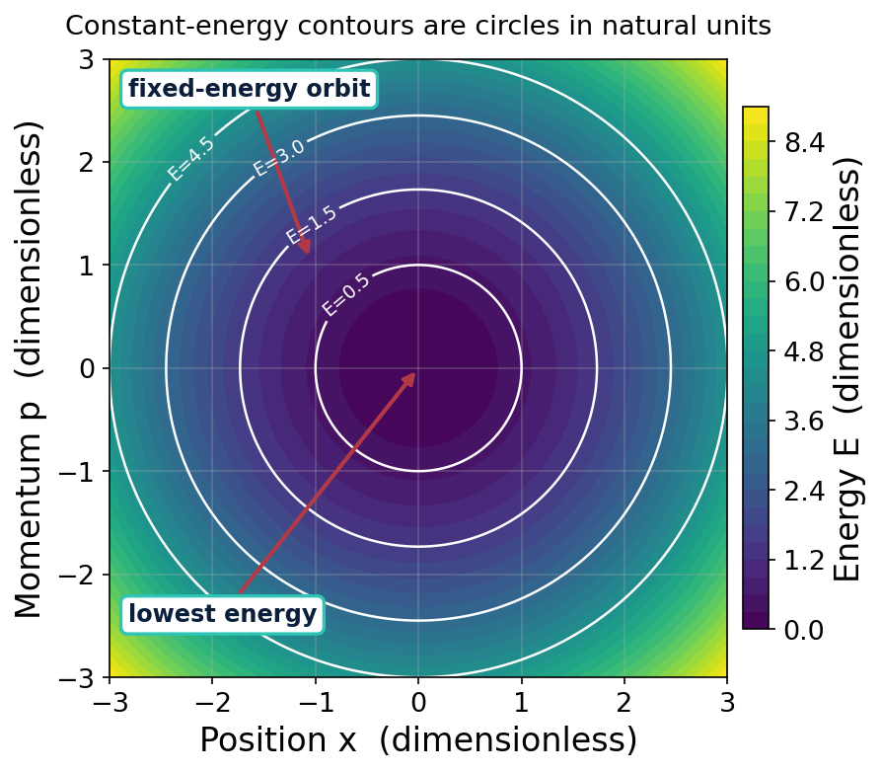
Component 1 · Task 1
Constant-energy contours are closed elliptical orbits in phase space.
WHAT IT SHOWS
Color is total energy E(x,p); white rings are constant-energy curves.
Each ring is one allowed classical orbit — the system is locked onto it.
In natural units the ellipses become circles; larger energy = larger ring.
This map defines the classical states the ML model will draw inputs from.
AI Design of Quantum Processors · Components 1 & 2
4

Slide 5
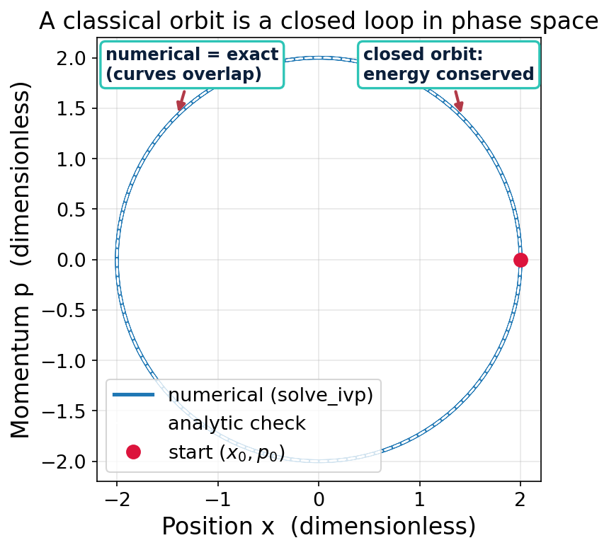
Component 1 · Task 2
Numerical trajectories match the exact solution and conserve energy.
WHAT IT SHOWS
solve_ivp steps Hamilton's equations forward in time to trace the orbit.
Numerical path overlaps the analytic solution — the solver is verified.
The orbit closes on itself and energy drift is only ~1e-9 — the solver conserves energy as it should.
Confidence here transfers to systems with no exact answer later.
AI Design of Quantum Processors · Components 1 & 2
5

Slide 6
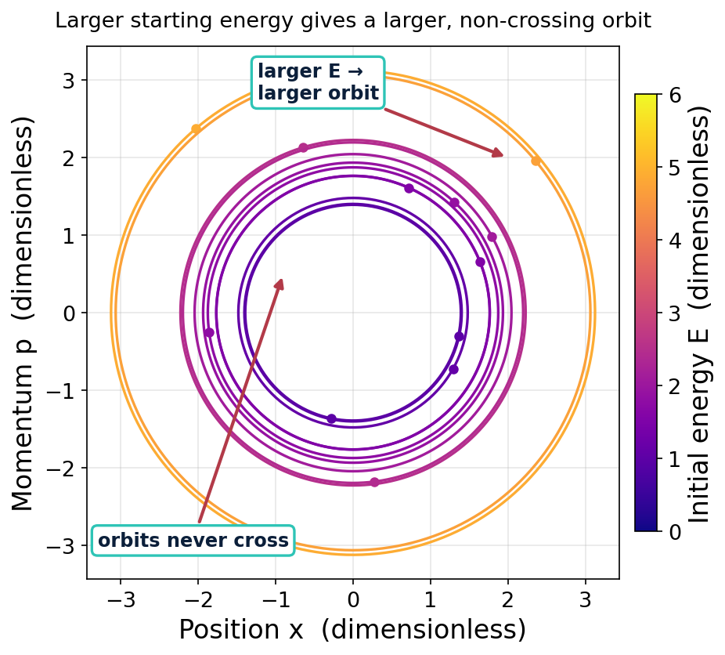
Component 1 · Task 2
Higher energy gives larger, non-crossing orbits — the classical feature set.
WHAT IT SHOWS
Twelve random initial conditions, each colored by its conserved energy.
Orbits never intersect: a unique state has a unique future.
Saved as classical_trajectories.npy — the inputs for Component 3.
Nested structure is exactly the 'feature space' ML will learn from.
AI Design of Quantum Processors · Components 1 & 2
6

Slide 7
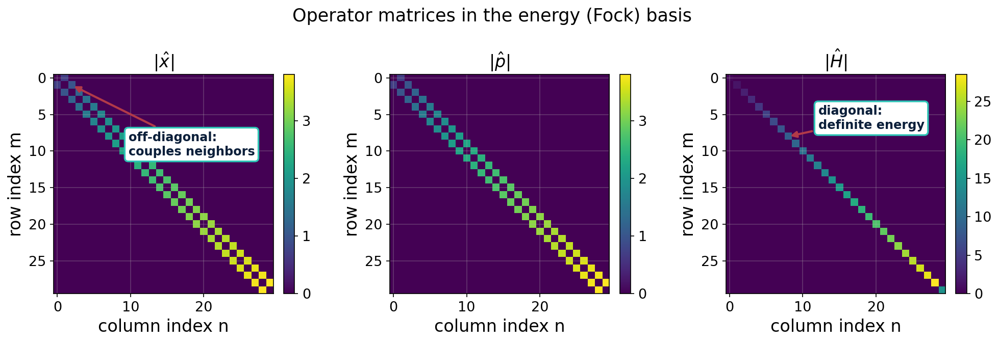
Component 2 · Task 1
The quantum operators reveal the ladder structure of the oscillator.
Takeaway: Ĥ is diagonal (each level has a definite energy), while x̂ and p̂ have only off-diagonal entries — they connect a level to its immediate neighbors.
AI Design of Quantum Processors · Components 1 & 2
7

Slide 8
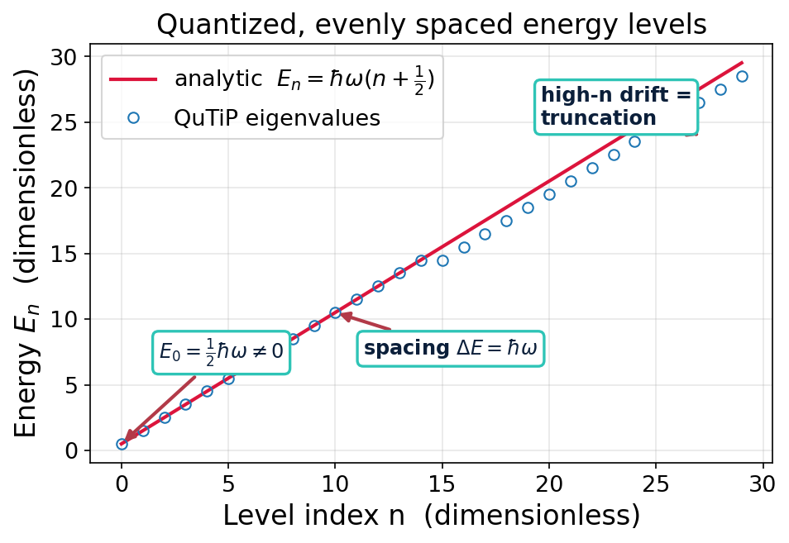
Component 2 · Task 1
Quantum energy is discrete, evenly spaced, with a nonzero zero-point energy.
WHAT IT SHOWS
QuTiP eigenvalues land exactly on the analytic line Eₙ = ℏω(n+½).
Ground state E₀ = ½ℏω ≠ 0 — a purely quantum effect.
Levels are equally spaced by ℏω (the ladder).
High-n points drift: the expected signature of finite truncation.
AI Design of Quantum Processors · Components 1 & 2
8

Slide 9
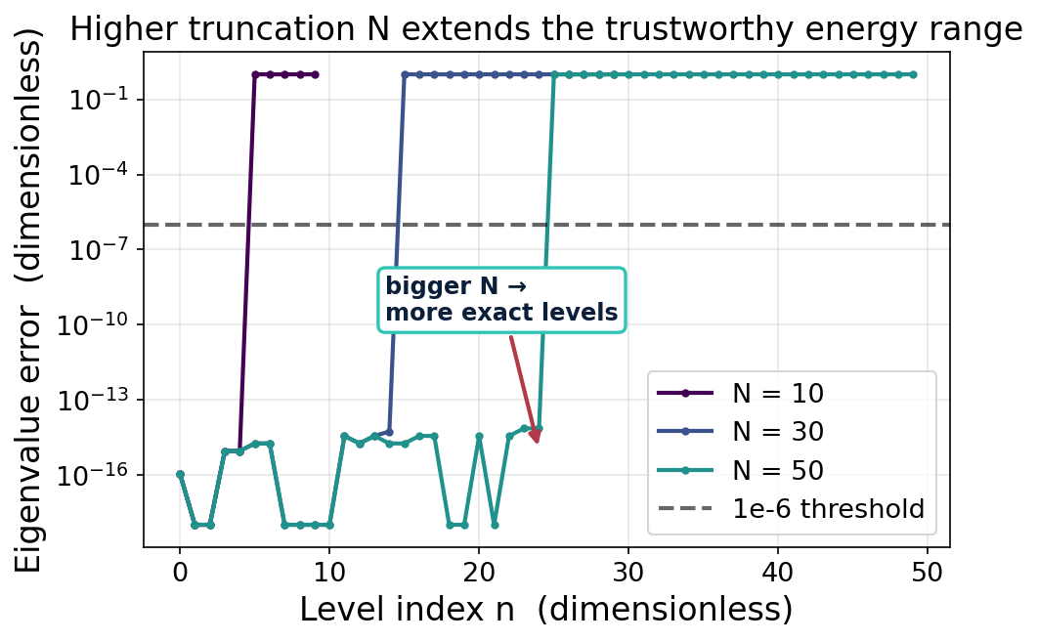
Component 2 · Task 1
The truncation level N sets how many energy levels are trustworthy.
WHAT IT SHOWS
Eigenvalue error stays at machine-zero for low levels, then blows up.
Roughly the lowest N/2 levels are exact for a given truncation N.
Raising N pushes the trustworthy range higher (N=10→5, 30→15, 50→25).
Rule: increase N until the quantity of interest stops changing.
AI Design of Quantum Processors · Components 1 & 2
9

Slide 10
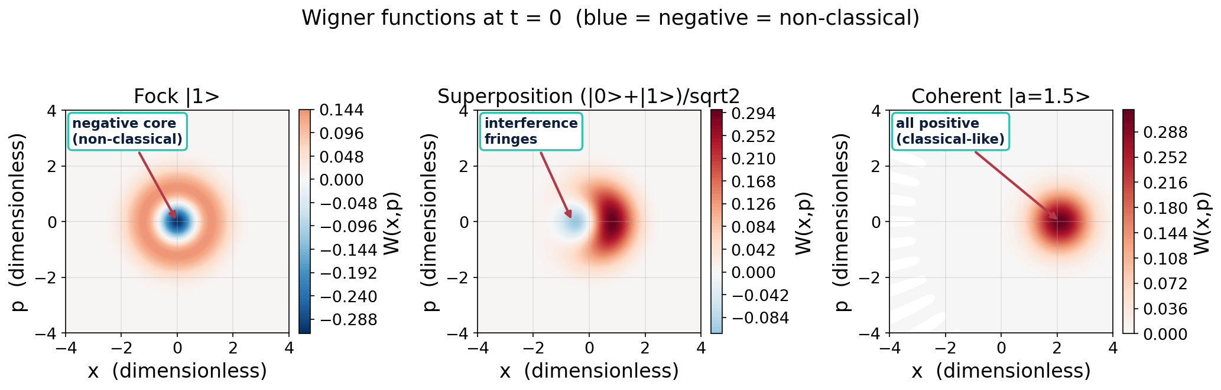
Component 2 · Task 2
Wigner functions expose non-classicality through negativity and interference.
Takeaway: The Fock state has a negative core and the superposition shows interference fringes (both impossible classically); the coherent state stays positive — the most classical state.
AI Design of Quantum Processors · Components 1 & 2
10

Slide 11
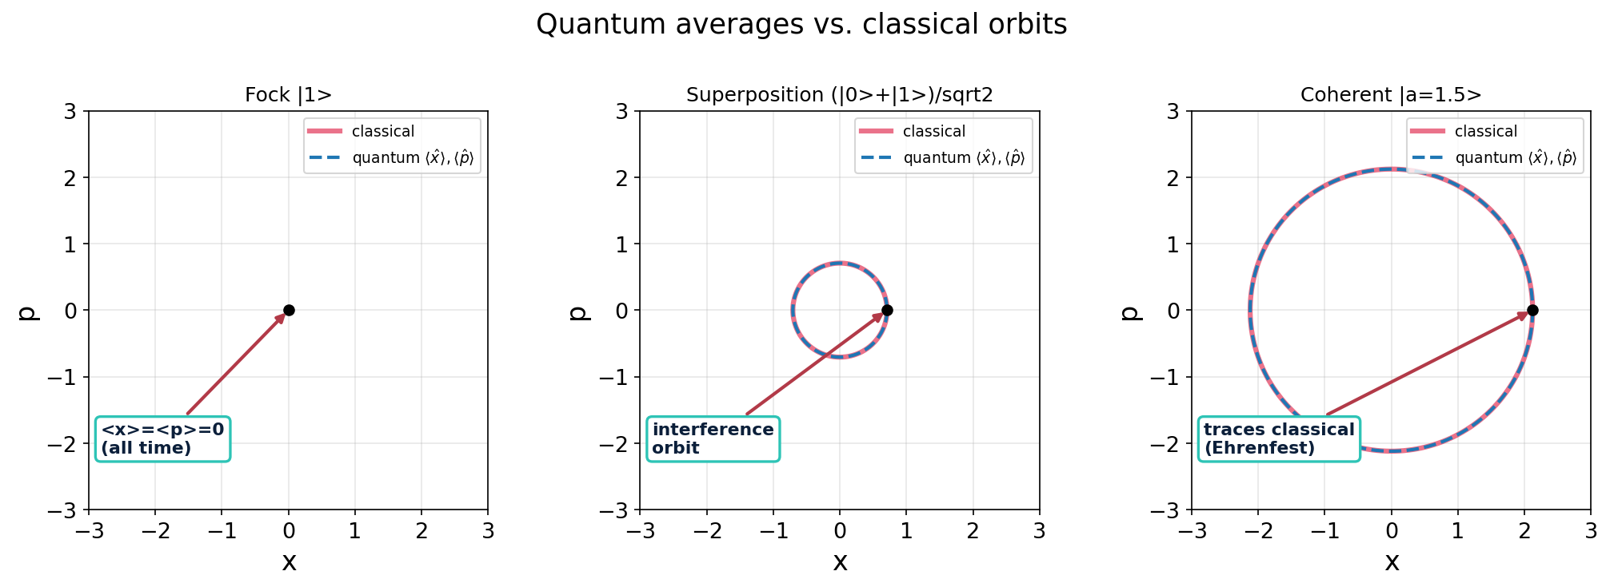
Component 2 · Task 2
Quantum averages trace the classical orbit, but averaging hides the spread.
Takeaway: For the coherent state ⟨x̂⟩,⟨p̂⟩ follow the classical circle exactly (Ehrenfest's theorem); the Fock state sits at the origin. The averages discard the variance and interference the Wigner picture keeps.
AI Design of Quantum Processors · Components 1 & 2
11

Slide 12
Open questions & next steps
What I don't yet understand
What I'd like to do next
What classical features best predict quantum targets — raw trajectories, energies, or phase-space densities?
How should the Wigner target be represented for ML (full grid vs. summary features)?
How far up in energy does the classical→quantum prediction stay reliable?
Where exactly does the classical picture break down (negativity, interference)?
Package Component 1 & 2 outputs into clean input/target pairs for Component 3.
Sweep more states and energies to enlarge the dataset.
Skim scikit-learn and pick a first model + validation plan.
Discuss with PI which quantum property to predict first.
AI Design of Quantum Processors · Components 1 & 2
12

